Slide 1
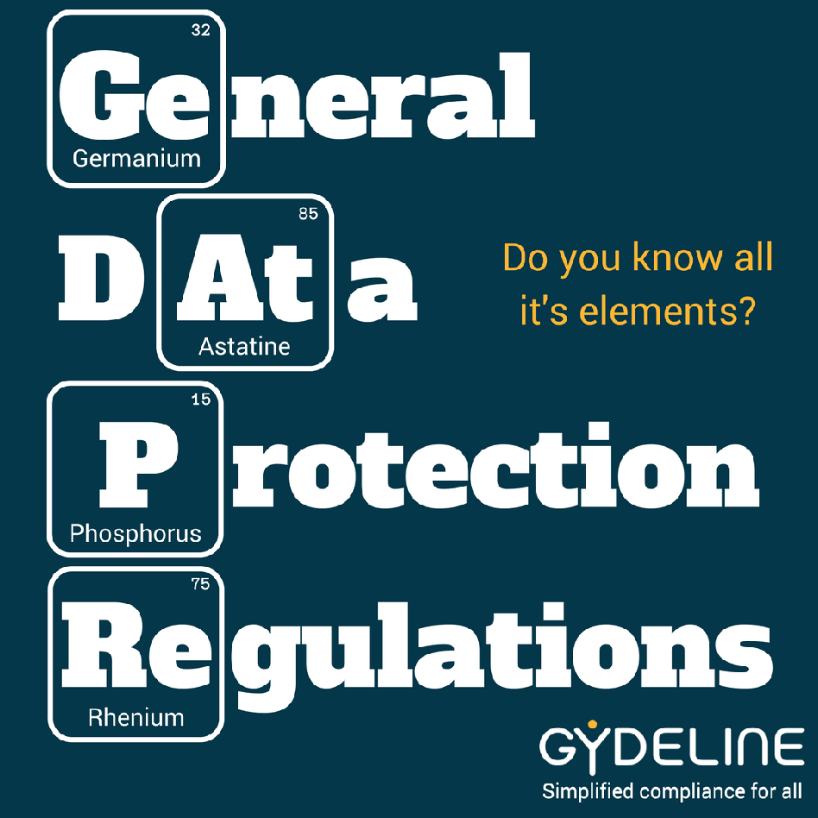
Introduction to GDPR
{Company}
{Date}
{Who presenting}
Notes:
Focusing on the basic requirements

Slide 2
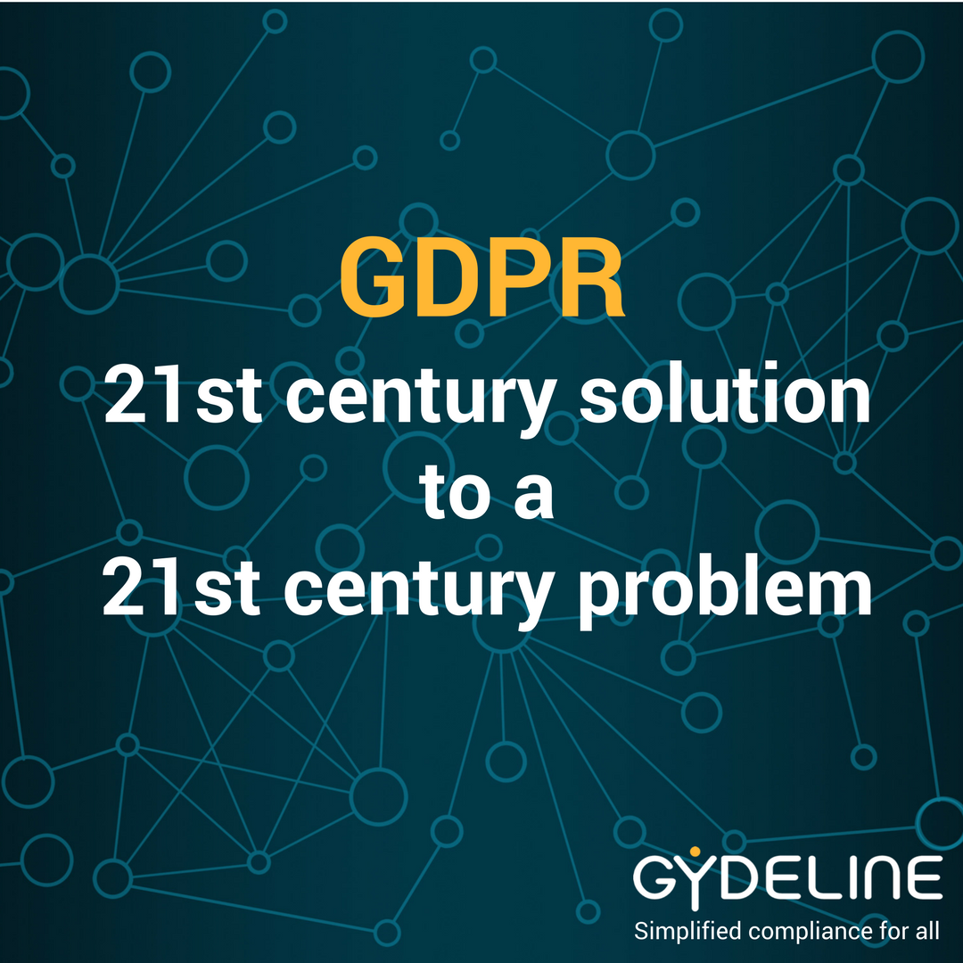
Why are we here?
Discuss how you use ‘personal data’
Understand your ‘data subjects’ rights
Learn how the company acts as a ‘controller’
Show what being a ‘processor’ means to you
Notes:
Law since 2016, Enforceable on 25 May 2018
Personal Data = ANYTHING that can identify a living natural person or Data Subject (ID, name, car reg, statistics…)
Controllers = those the decide what will be done with personal information - usually a company, but can be an individual… like YOU
Processors = anyone who handles personal data on behalf of a controller (controller can be a processor)

Slide 3
Why is GDPR needed?
Data Protection
Act 1998
YouTube
Instagram
Pokemon Go
Friends
Reunited
Google
StreetView
Facebook
Tinder
GDPR!
?
1995
2000
2005
2010
2015
4G Mobile
Network
8 billion
Internet
Connected
Devices
Bluetooth
3G Mobile
Network
Apple
iPhone
5.9 million
CCTV Cameras
Notes:
Facebook - 2.2 Billion active monthly subscribers
StreetView - got some people in trouble with cars parked in the wrong place
8 billion IoT : Article on Speaker systems and profiling, Tracking Sträva users in War torn areas
Profiling - facial recognition - ‘big data’

Slide 4
What is Personal Data?
Information that can be used to identify a “natural person” (Data Subject), such as:
Name, contact details
ID numbers (NI, HMRC)
Location data
Online identifiers (e.g. IP address)
Images
Small sample statistics!
Notes:
In order to avoid confusion, the GDPR applies to personal data. Personal data is one of the following. Personal data relates to a natural person rather than any organisation. GDPR applies to the data irrespective of whether it is stored on electronic, paper or any other type of filing system. Filing implies that the data is structured and searchable in some way as opposed to random and unsearchable.

Slide 5
Special categories
a.k.a. Sensitive Data
Racial or ethnic origin
Political opinions
Criminal
Religious or philosophical beliefs
Trade union membership
Genetic data
Biometric data (to identify person)
Health data
Sex life
Sexual orientation
Children under 13
Notes:
Some types of personal data attract special consideration under the GDPR and so are worth noting.

Slide 6
What is Processing?
Any activity which is:
Performed on personal data
Done on a computer or on paper
Things like:
collection
filing and storing
referring to, changing or updating
making available to others
erasure or destruction
Notes:
In order to avoid confusion, the GDPR applies to personal data. Personal data is one of the following. Personal data relates to a natural person rather than any organisation. GDPR applies to the data irrespective of whether it is stored on electronic, paper or any other type of filing system. Filing implies that the data is structured and searchable in some way as opposed to random and unsearchable.

Slide 7
Basic GDPR Principles
Fair, lawful and transparent processing
Correct, stated purpose
Data minimisation
Accurate and up to date
Kept no longer than necessary
Secure
Accountable (Controllers & Processors)
Notes:
The GDPR enshrines some basic data protection principles. It also requires that organisations are able to demonstrate their compliance with the GDPR – the Gydeline software is one way of demonstrating an organisations compliance position.

Slide 8
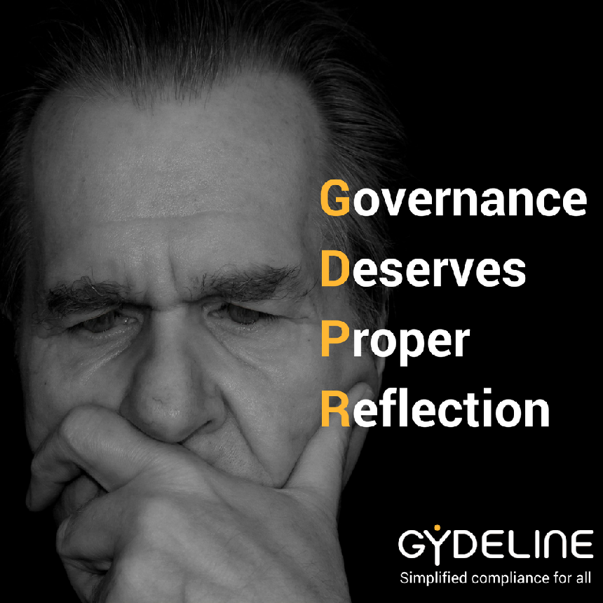
Who’s Accountable?
Controller
Your organisation
Processors
You!
Other organisations that process personal data for your controller
Data Protection Officer (DPO)
Notes:
The GDPR enshrines some basic data protection principles. It also requires that organisations are able to demonstrate their compliance with the GDPR – the Gydeline software is one way of demonstrating an organisations compliance position.

Slide 9
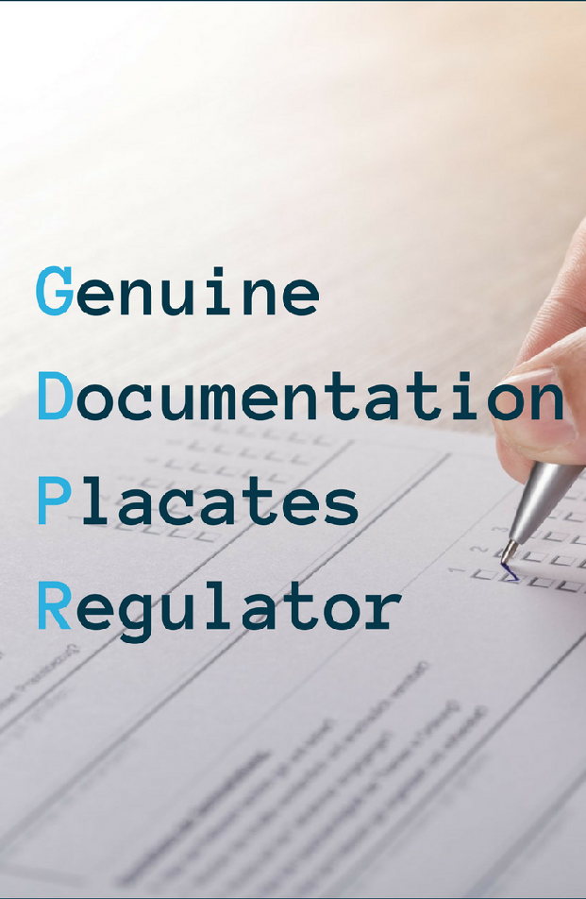
How do we do that?
Information Audit & Data Map
Impact Analysis
Identify the legal basis we use for processing
Appoint a DPO
Improve processes
Improve systems
Notes:
Consent - explicit/specific, transparent, clear, open
Contract - but contracts need reviewing, may not be able to rely on poorly worded contracts
Legal Obligation - Another act or regulation that requires the processing
Vital interests - Health, wellbeing of the data subject
Public Task - Government
Legitimate Interests = Common Interests (no real chance of objection)
Data Mapping

Slide 10
What data do we use?
What
Where
Why
Where from
Permission
Shared with
Employees
name, email, phone, address, DoB, NI, bank, Emergency Contacts,
HR Files
Email
Finance System
Payroll System
Phones
Give them a job
Pay them
Contact them
Employee
Contract of employment
Government
Customers
name, email, phone, address, history
Email
Manual filing
Finance System
Phones
Deliver services
Fulfil contract
Update them
Promotion
Customer
Terms & conditions
(contract)
Consent
Employees
Suppliers
name, email, phone, address
Email
Manual filing
Finance System
Phones
Receive services
Update them
Supplier
Terms & conditions
(contract)
Legitimate Interest
Employees
Contacts
name, email, phone, address, social profiles
Email
Manual filing
Phones
Provision of Information
Promotion
Emails
Forms
Referrals
Face to face
Consent
Legitimate Interest
Employees
Notes:
Illustrative

Slide 11
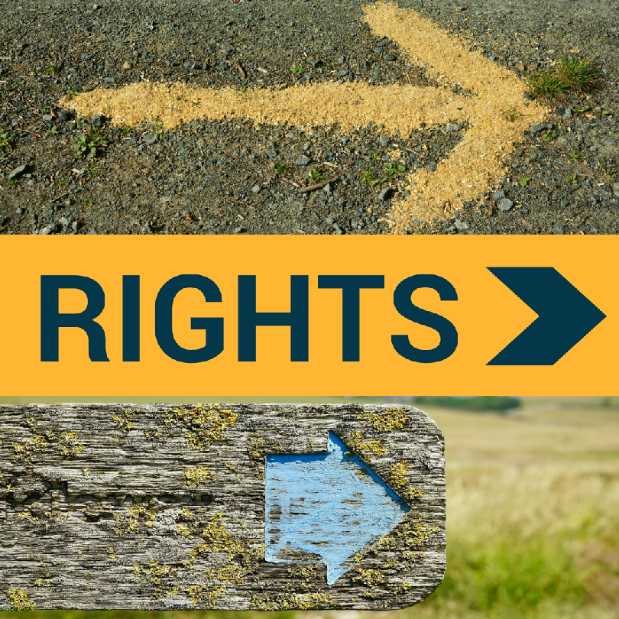
Data Subject Rights
to be informed (Privacy notice)
of access
to rectification
to erasure
to restrict processing
to data portability
object
not to be subject to automated decision making and profiling
Notes:
The GDPR gives rights to the data subject. Organisations should be aware of, and have processes, to support all these rights.

Slide 12
What is a Privacy Notice?
Individuals have the right to be informed about the use of their personal data. Specifically,
The purposes for processing their data
Your retention periods for that personal data
With whom it will be shared
How you process the data
The rights of the data subject
Notes:
General privacy notice supported by specific, explicit, clear and understandable details when collecting data
May be a call for variations for employees, suppliers and customers to avoid fogging it for another type of data subject
Right to be informed
Right of access
Right to rectification
Right to erasure
Right to restrict processing
Right to data portability
Right to object
Right not to be subject to automated decision making and profiling.

Slide 13
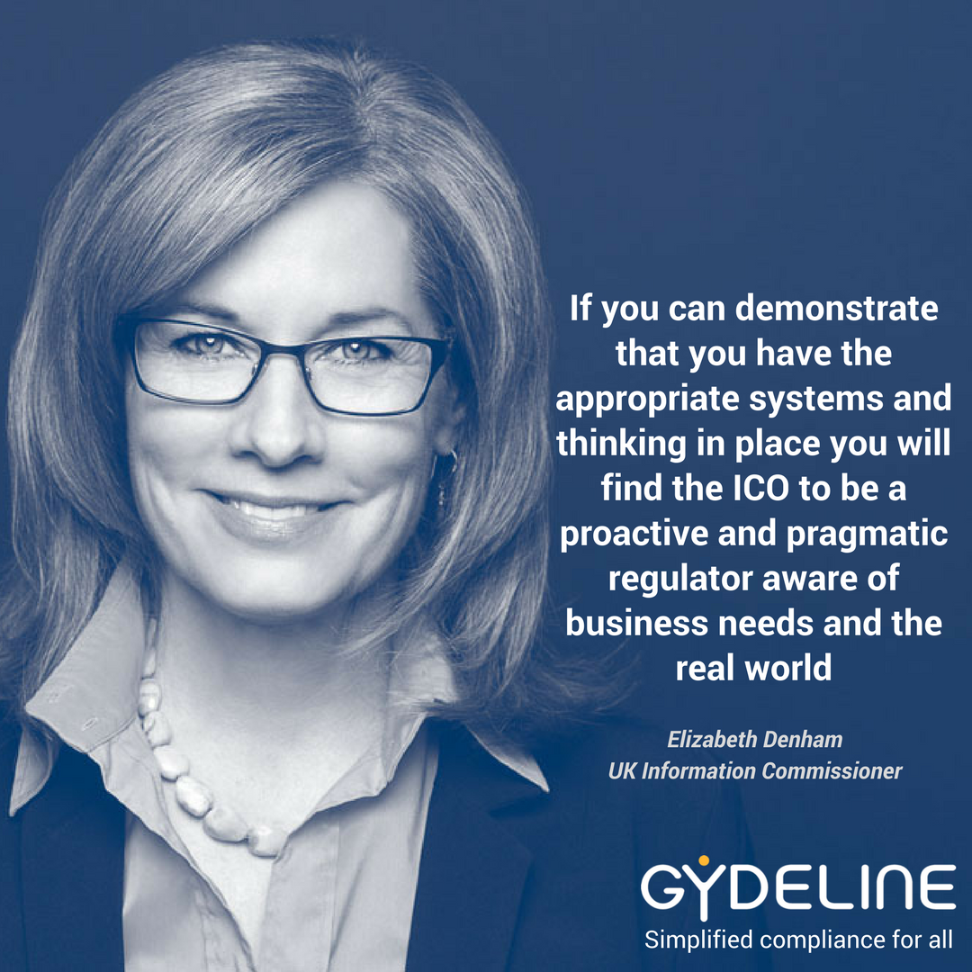
What do we need to do?
Know our data
Improve ‘systems’
Change ‘thinking’
Establish a culture of compliance
Notes:
Reading between the lines of quote - if you haven’t got your systems and thinking in place…

Slide 14
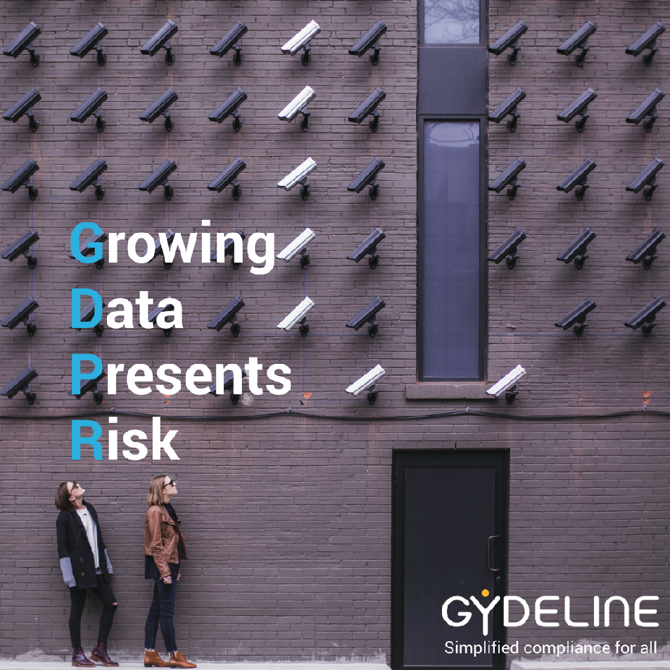
Change Our ‘Thinking’
Think from individuals perspective
What could happen?
How could we reduce the risk?
Do they know what we are doing with their data?
Notes:
Data Protection Impact Assessment - Understand what could happen if the personal data you process falls into the wrong hands
If you lose it - what would be the impact. If you divulge it to someone who doesn’t have the right to it - what’s the impact.
Consider the data subject and the consequences to your organisation

Slide 15
Improve Our ‘Systems’
Must work together to keep our clients data safe
Be transparent and clear on privacy arrangements
Work within policies and processes
Maintain documented and recorded procedures
Use the provided secure systems (e.g. IRIS)
Dispose of unneeded personal data
Understand the Controller and DPO roles
Notes:
Revising policies - make sure you read and understand them
Comply with and use Secure Systems
Erasing email

Slide 16
Your Responsibilities
Treat personal information with respect
Maintain good physical and IT security
Lock things away
Use strong passwords
Use proper systems to share personal information
Report any concerns - don’t sit on them
Be vigilant - the routes of attack are changing
Co-operate with the ICO if required
If anything is new or changes then ask
Notes:
Email - forwarding - retention

Slide 17
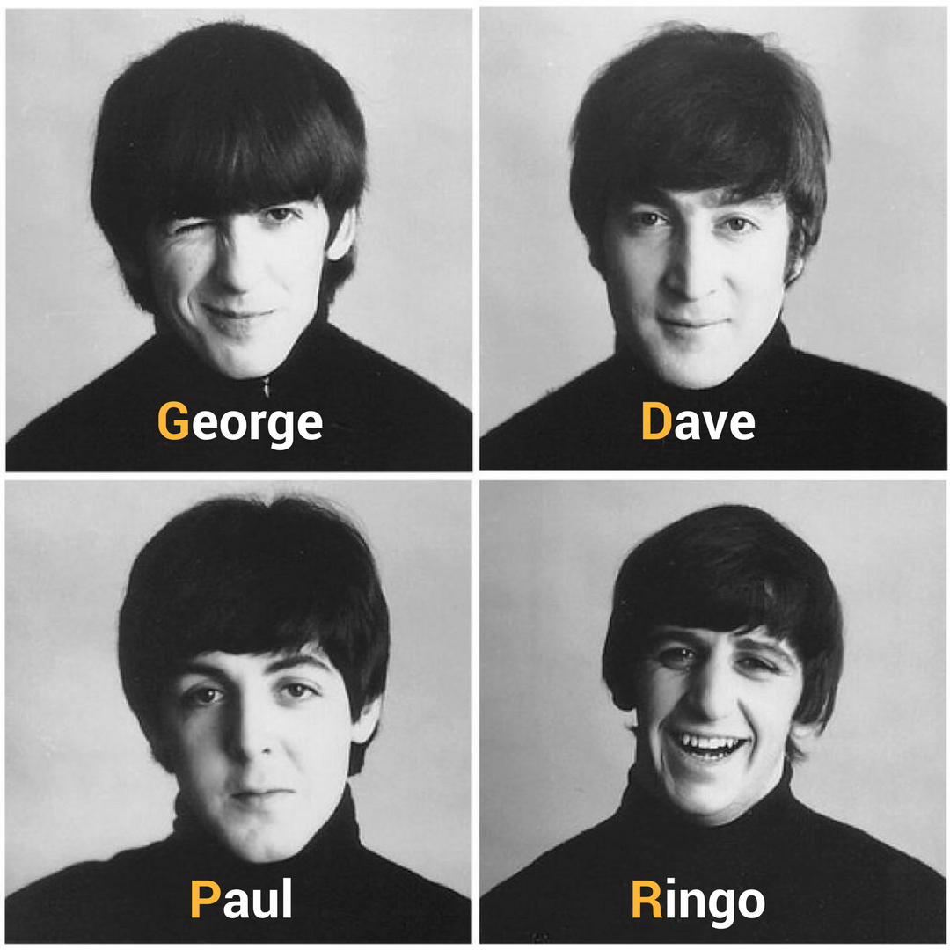
Thank you
Questions always welcomed
hello@gydeline.com
www.gydeline.com

